Slide 1
CS-207
APPLIED DATABASES PRACTICUM
Made By-
Bhumesh Gaur

Slide 2
PROBLEM STATEMENT
Railway Booking System

Slide 3
TABLE OF CONTENTS
BACKEND
01
FRONTEND
02
A.
03
B.
PASSWORD
ENCRYPTION
C.
Login and Register Page
DATABASE
Home Page
Train Search and Booking page
04

Slide 4
FRONTEND
HTML
CSS
JavaScript

Slide 5
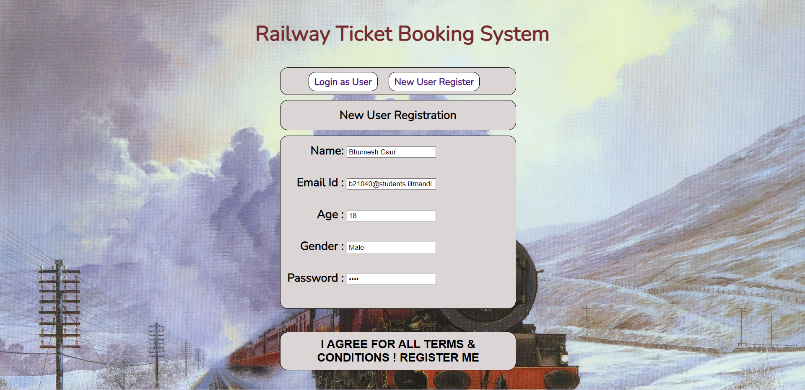
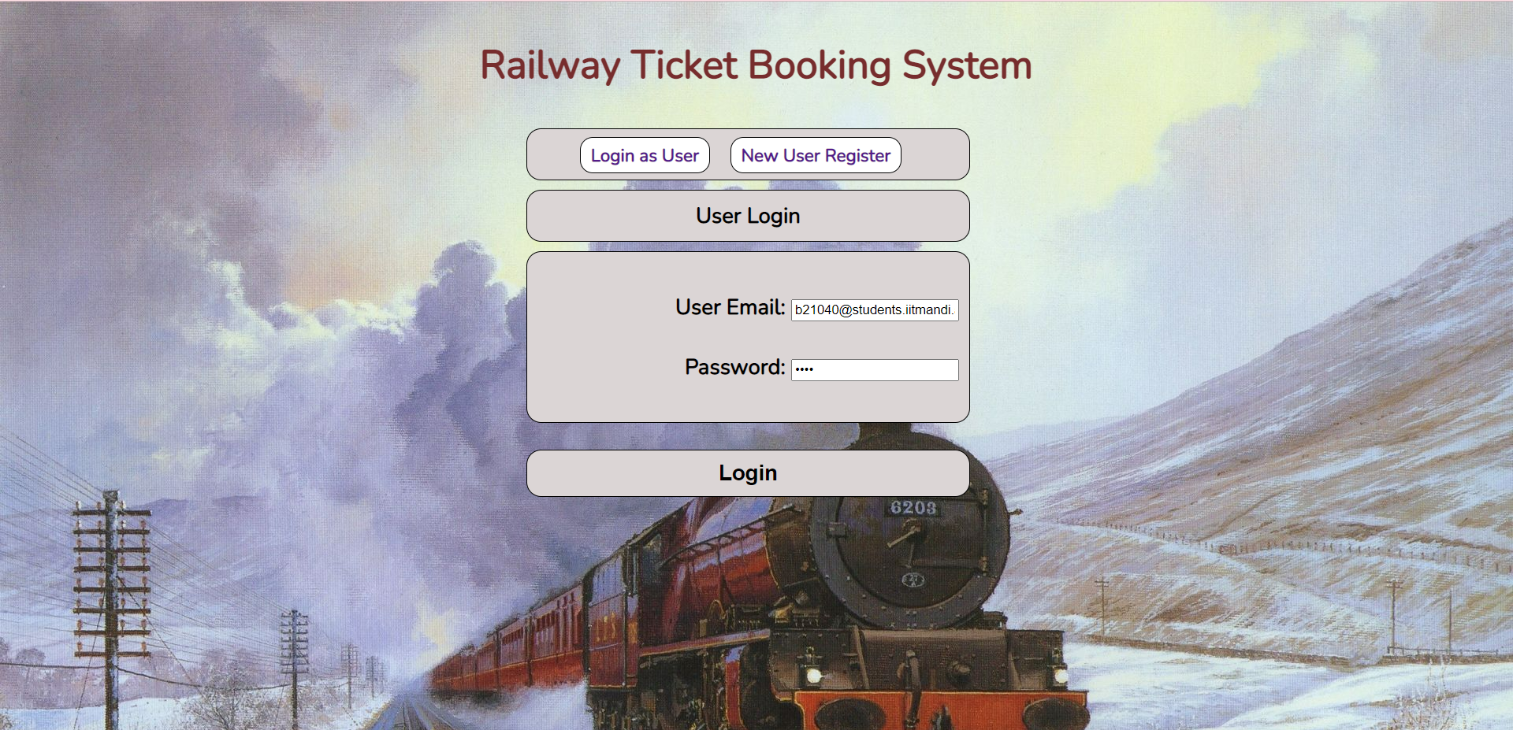
LOGIN AND REGISTER PAGE
REGISTER PAGE
LOGIN PAGE
The user enters the credentials for which an account has to be created, and secures it with a password
The user logins with his username and password, and gets redirected to the home page of their account.

Slide 6
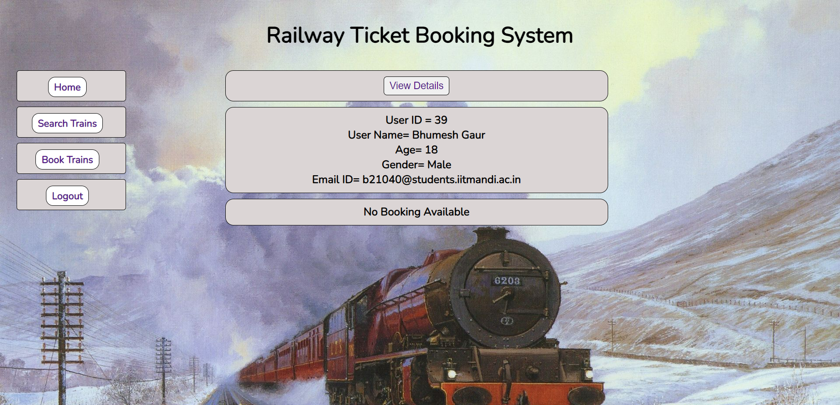
HOME PAGE
The logged in user gets an option to view his/her booked seats, and a side panel to navigate to various sections; and to logout.

Slide 7
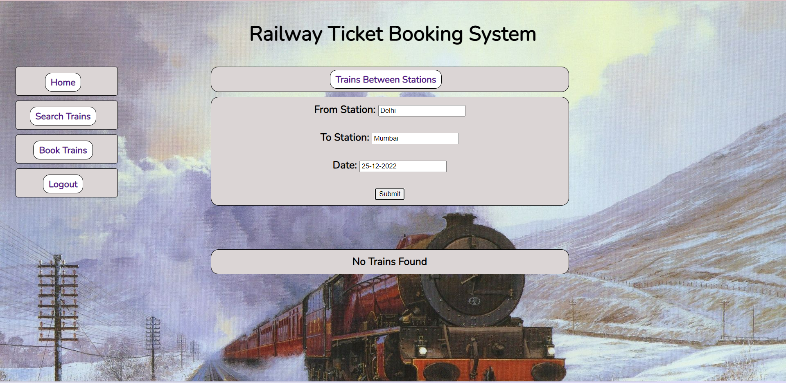
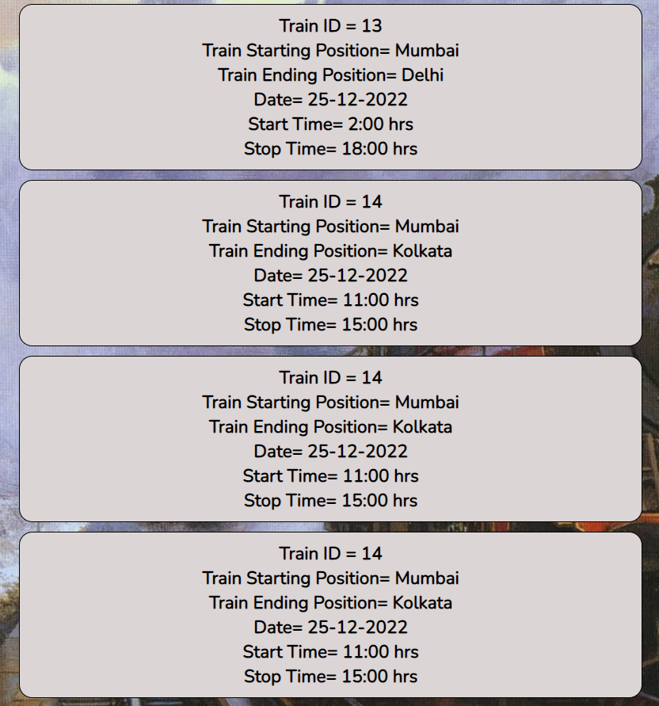
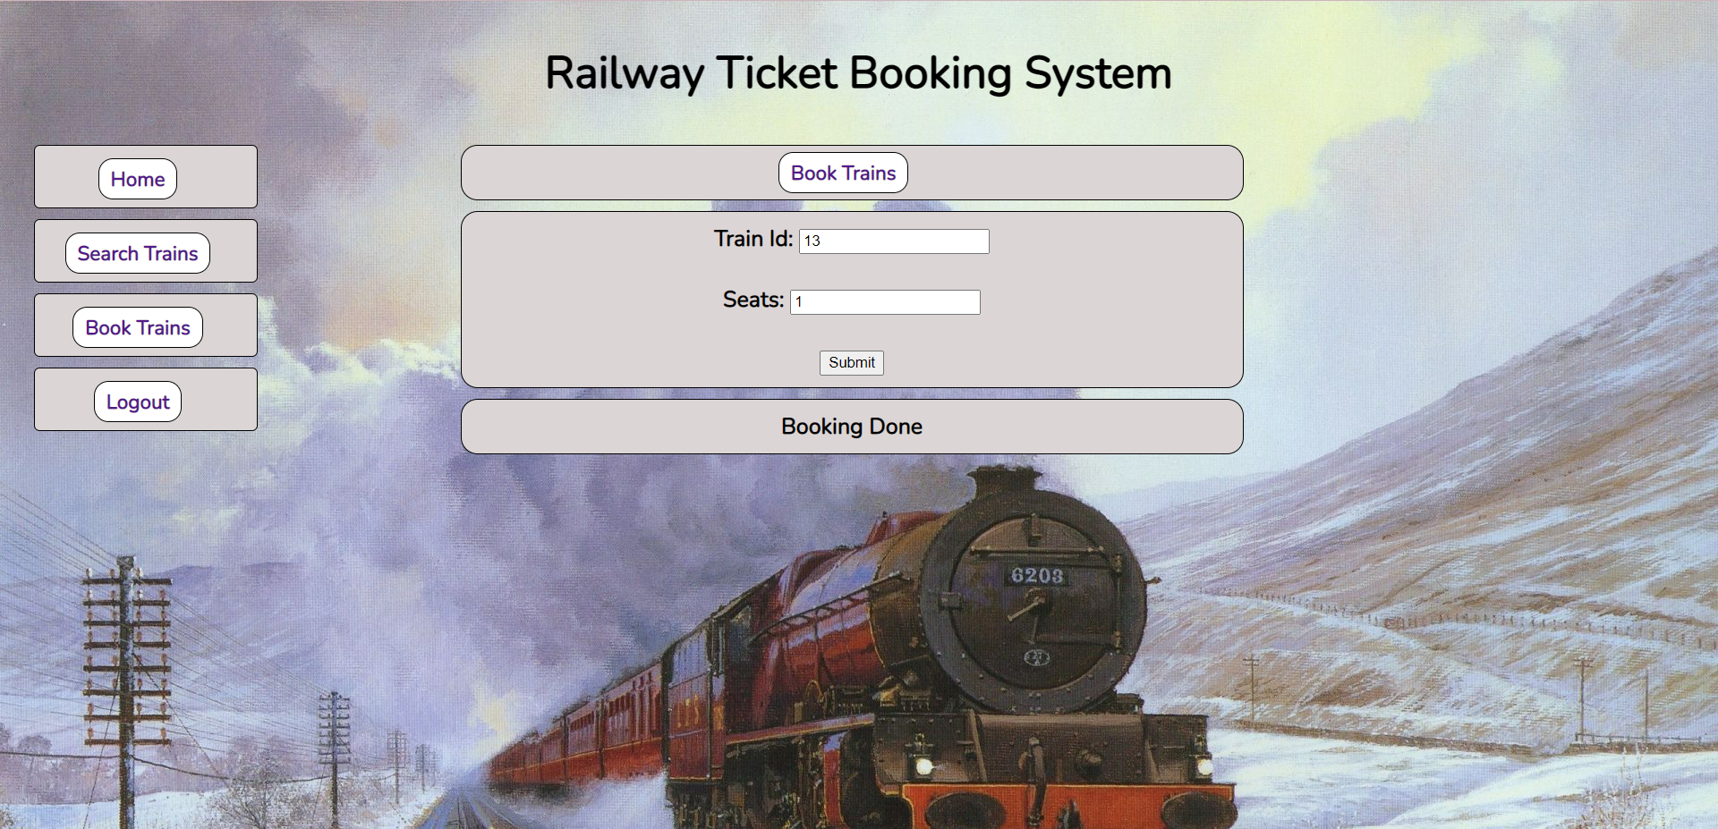
BOOKINGS
TRAIN SEARCH
The user can enter the cities and date to check trains and seats remaining in those trains.
BOOKING
Using train ID, the user can request to book certain number of seats in the train.
VIEW BOOKINGS
The user can view the details of his/her booked seats on the home page

Slide 8
BACKEND
MySQL
ExpressJS

Slide 9
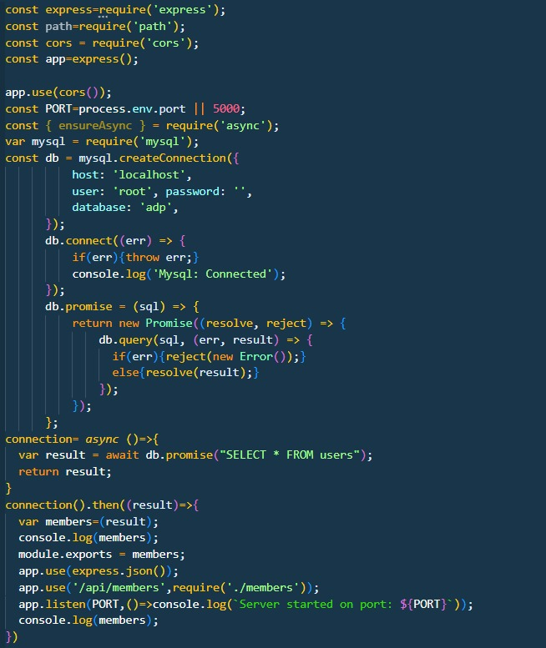
BACKEND Demonstration
We are using APIs in members.js file so that we can access the data from database to our frontend.
Using Router we can send response to our desired data from the database and using javascript we can access the desired data on our front end page

Slide 10
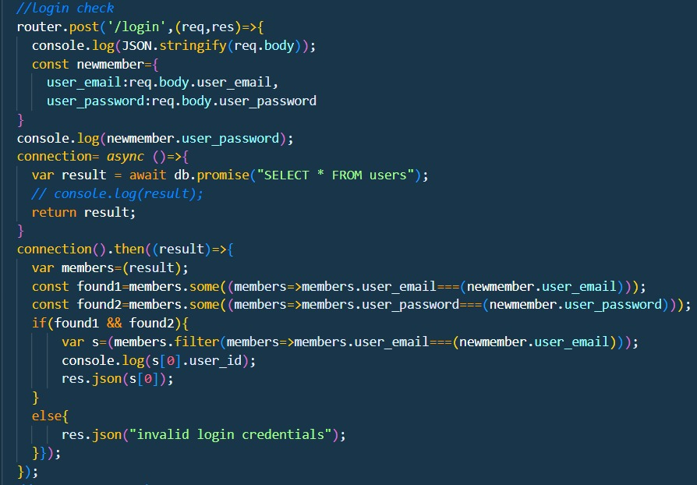
APIs :
API stands for Application Programming Interface. APIs are mechanisms that enable two software components to communicate with each other using a set of definitions and protocols.

Slide 11
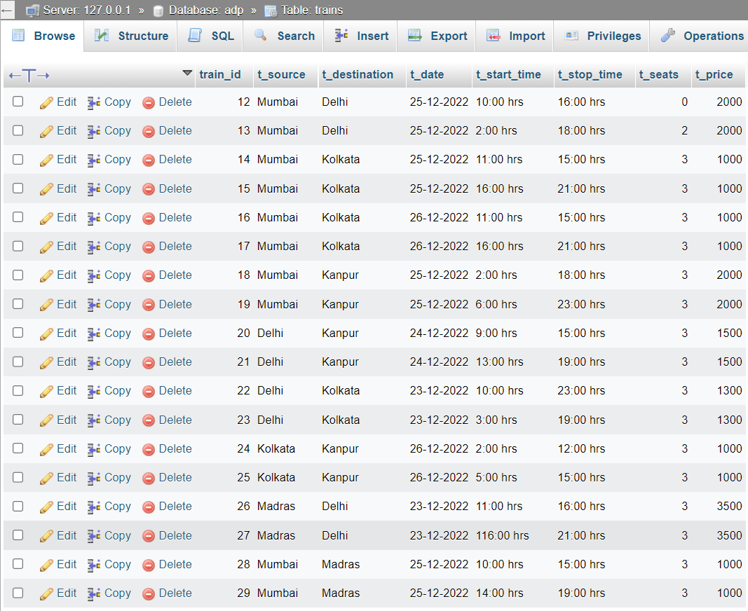
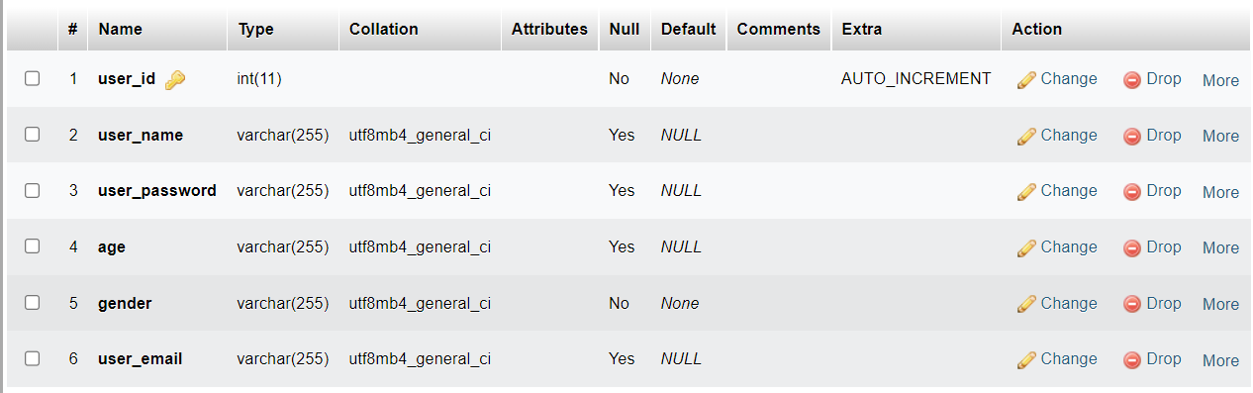
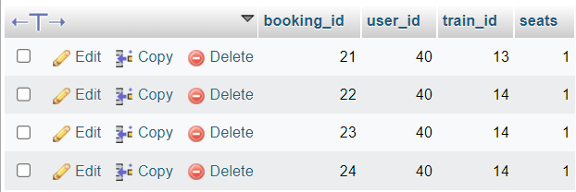
DATABASE
Users Table
Trains Table
Bookings table
A self created database using MySQL is used for the trains. The database consists of three tables

Slide 12
PASSWORD ENCRYPTION
The password submitted by user for registering is encrypted using SHA-256 model to ensure that even if someone gets access to backend, he does not have any the passwords of the users.

Slide 13
THANK YOU!!

